Slide 1
CSCI 1145 – Unit 1
History of the Internet

Slide 2
Expected Learning Outcomes
Understanding of Internet history and the genesis of the WWW
W3C Web Standards
Accessibility on the Web
Client-Server model as it applies to the Internet
Internet network protocols
URI, URL, Domains
Overview of HTML and HTML 5 language

Slide 3
The Internet
Internet technology goes back 40 years, but the current form of the WWW has exploded in the last two decades
Due in part to the commercialization of the Internet in ‘95
Affordable home PCs
Better access to ISPs
Mobile devices
Source - Floyd, Kevin and Kwak, Myungjae, "Web Development" (2016). Computer Science and Information Technology Grants Collections. 7. https://oer.galileo.usg.edu/compsci-collections/7 Licensed by CC-BY

Slide 4
The World Wide Web
Main goal is to make the Internet “user friendly”
Via GUI-based browsers
Tim Berners-Lee coined World Wide Web in 1990
Helped to set Web standards
Uniform Resource Locator (URL) – addressing scheme for the web
HyperText Transfer Protocol (HTTP) – network rules for transmitting web pages
HyperText Markup Language (HTML) – coding language to create web pages
Helped found the World Wide Web Consortium (W3C) – maintains web standards
1993 Mosaic Browser - First GUI based point-and-click browser
Source - Floyd, Kevin and Kwak, Myungjae, "Web Development" (2016). Computer Science and Information Technology Grants Collections. 7. https://oer.galileo.usg.edu/compsci-collections/7 Licensed by CC-BY

Slide 5
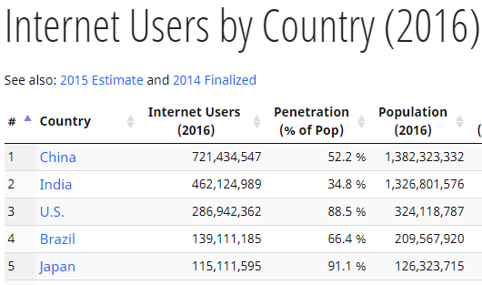
The World Wide Web Today
Internet: Convergence of technologies for the purpose of sharing information electronically
Internet is not a singular entity
System of interconnected networks using communication protocols
Hypertext Transfer Protocol - HTTP
Transmission Control Protocol - TCP
Internet Protocol - IP
File Transfer Protocol – FTP
Simple Mail Transfer Protocol – SMTP
WWW is the primary infrastructure to deliver information around the world today
Internet Live Stats – almost 4 billion Internet users today and growing
Over 40% of world population on the Internet
Source - Floyd, Kevin and Kwak, Myungjae, "Web Development" (2016). Computer Science and Information Technology Grants Collections. 7. https://oer.galileo.usg.edu/compsci-collections/7 Licensed by CC-BY

Slide 6

Internet Standards and Accessibility
World Wide Web Consortium (W3C) Sets Web standards
Define an Open Web Platform for application development that has the potential to enable developers to build rich interactive experiences, powered by vast data stores, that are available on any device - (“Standards - W3C,” n.d.)
Web Standards and Accessibility
When websites and web tools are properly designed and coded, people with disabilities can use them. However, currently many sites and tools are developed with accessibility barriers that make them difficult or impossible for some people to use. Making the web accessible benefits individuals, businesses, and society. International web standards define what is needed for accessibility. - (w3c_wai, n.d.)
What exactly is Web Accessibility?
Websites, tools, and technologies designed and developed so that people with disabilities can use them. I.e. people can perceive, understand, navigate, and interact with the web as well as contribute
Encompasses all disabilities that affect Web access:
Auditory, cognitive, neurological, physical, speech, visual
Also accounts for people without disabilities
Using small screen devices
Bandwidth
Age, temporary disabilities, situational limitations
ADA – Click to read the official act
Sources - Standards - W3C. (n.d.). Retrieved July 10, 2018, from https://www.w3.org/standards/
w3c_wai. (n.d.). Introduction to Web Accessibility. Retrieved July 10, 2018, from https://www.w3.org/WAI/fundamentals/accessibility-intro/

Slide 7
Universal Design Principles
Principles that promote accessible websites
Equitable Use – Design for all users
Flexibility in Use – Promotes flexible, adaptable, and customizable design
Simple and Intuitive Use – Reduce complexity and mental cognitive load
Perceptible Information – Consider presentation for those with disabilities
Tolerance for Error – Design error-friendly environment
Low Physical Effort – Minimize physical interactions
Size and Space for Approach and Use – Design for big and small devices
Source - Zheng, R. (n.d.). Learn to Create Accessible Websites with the Principles of Universal Design. Retrieved July 11, 2018, from https://www.interaction-design.org/literature/article/learn-to-create-accessible-websites-with-the-principles-of-universal-design

Slide 8
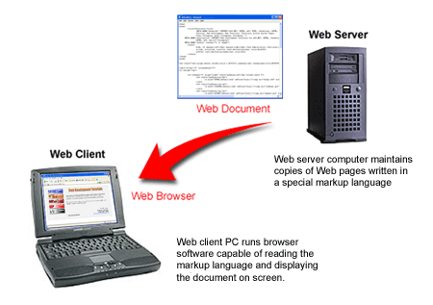
Serving Web Pages
Two types of computers are required to share docs on the Internet
Client-Server Model
Web Server – Store and serve up webpages
Client computer – Link to server to access stored web documents
Use browser software to view web documents
Chrome
Safari
FireFox
IE/Edge
Source - Floyd, Kevin and Kwak, Myungjae, "Web Development" (2016). Computer Science and Information Technology Grants Collections. 7. https://oer.galileo.usg.edu/compsci-collections/7 Licensed under CC-BY

Slide 9
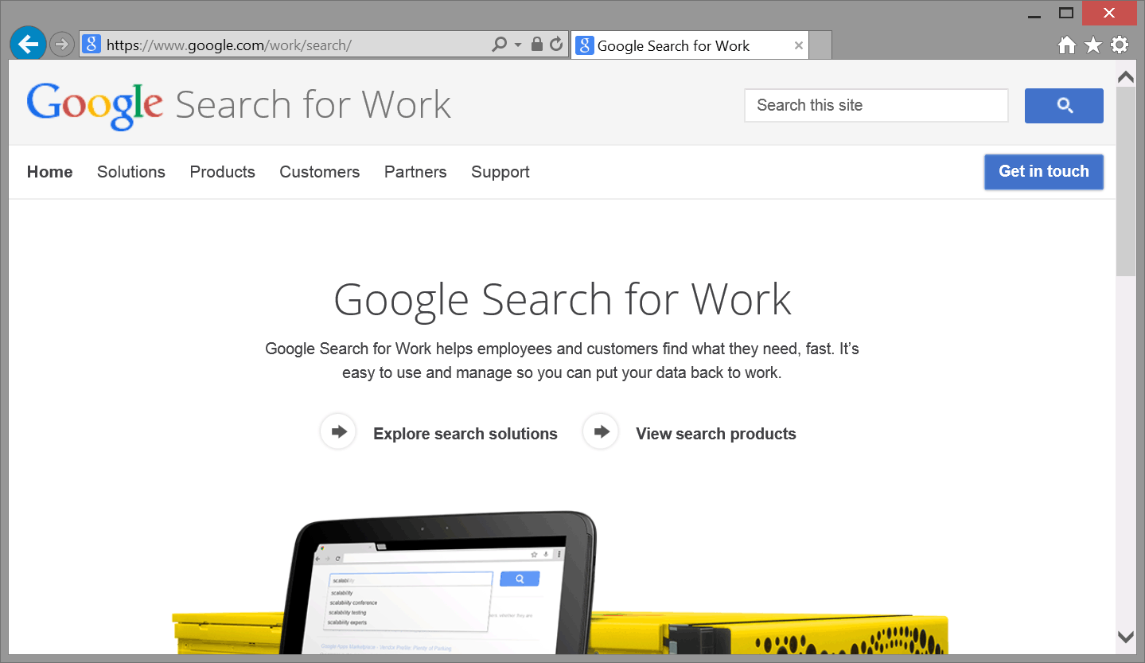
Accessing Web Documents
Web pages are retrieved with special addressing scheme
Uniform Resource Identifier (URI) – Identifies a resource on the Internet
Uniform Resource Locator (URL) – Special URI representing network location of a resource such as a web page.
Address you enter into the browser’s address box
Ex. https://www.google.com/work/search
Source - Floyd, Kevin and Kwak, Myungjae, "Web Development" (2016). Computer Science and Information Technology Grants Collections. 7. https://oer.galileo.usg.edu/compsci-collections/7 Licensed under CC-BY

Slide 10
URL Components
https://www.google.com/work/search/
Protocol – specifies the network transmission method
Domain Name – specifies the name of the web server
Path to file – specifies the directory/folder path to the web file
Typically need to know exact name of the web page file to retrieve it, but if the page is named index.html/default.html it will be retrieved automatically and doesn’t need to be in the URL.
Source - Floyd, Kevin and Kwak, Myungjae, "Web Development" (2016). Computer Science and Information Technology Grants Collections. 7. https://oer.galileo.usg.edu/compsci-collections/7 Licensed under CC-BY

Slide 11
Domain Names
Provide a human-readable address for any web server available on the Internet. such as www.google.com
Without domain names we would have to remember every web server’s IP address
IP address consists of 32 bits for IPv4 written as four numbers between 0 – 255
E.g., 173.194.121.32
IPv6 addresses consist of 128 bits and are written as eight groups of four hexadecimal numbers
E.g., 2027:0da8:8b73:0000:0000:8a2e:0370:1337
Not feasible for humans, therefore we use domain names
Translation of names to IP is achieved through the Domain Name System (DNS)
Sources - Learning HTML: Guides and Tutorials" by Mozilla Developers Network is licensed under CC BY-SA 2.5

Slide 12
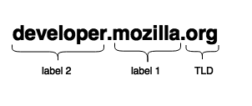
Domain Names Continued
Domain name structure – simple structure made of several or one party only
Names read from right to left
Each part provides specifics about the whole domain name
TLD (Top-Level Domain) – provides most generic domain name information
Most general TLD’s: .com, .org, .net
Some offer policy enforcement such as: .us, .fr, .sh
E.g., require the page to be in a certain language or hosted in a certain country
Subdomain/SLD (Secondary Level Domain)/Label
In the figure above Label 2 would be the subdomain of the Mozilla.org domain
Fully Qualified Domain Name (FQDN) – specifies exact location in tree hierarchy of the Domain Name System
Sources - Learning HTML: Guides and Tutorials" by Mozilla Developers Network is licensed under CC BY-SA 2.5

Slide 13
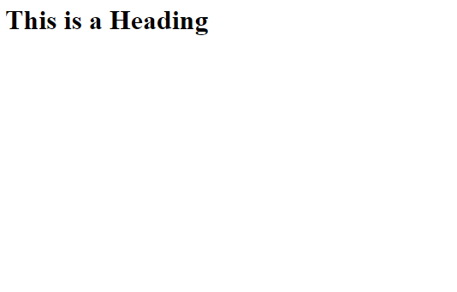
HTML Overview
HTML is markup language not a programming language
Formatting instructions for how web page information should be presented on screen
Markup codes referred to as elements or tags
Enclosed inside “<“ and “>“ symbols to distinguish them from standard text content
The opening tag “<“ indicates beginning of formatting, “>” indicates end of formatting
Certain elements called standalone elements don’t have a closing tag such as <img>, <br> and <hr>
Coding HTML pages versus WYSIWYG pages
What You See is What You Get – Dreamweaver, Visual Studio, Wordpress, etc. write the HTML for you
In traditional coding, you write every tag and have total control over the design
This course only allows for traditional coding through a text-editor
Source - Floyd, Kevin and Kwak, Myungjae, "Web Development" (2016). Computer Science and Information Technology Grants Collections. 7. https://oer.galileo.usg.edu/compsci-collections/7 Licensed under CC-BY
<h1>This is a Heading</h1>
Browser Ouput – Online example

Slide 14
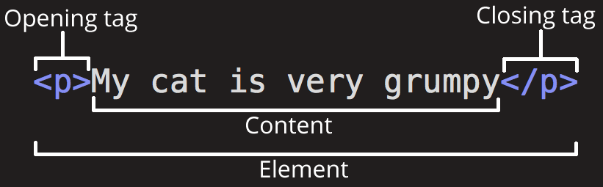
HTML Element Anatomy
Opening tag: This consists of the name of the element (in this case, p), wrapped in opening and closing angle brackets. This states where the element begins or starts to take effect — in this case where the start of the paragraph is.
Closing tag: This is the same as the opening tag, except that it includes a forward slash before the element name. This states where the element ends — in this case where the end of the paragraph is. Failing to include a closing tag is a common beginner error and can lead to strange results.
Content: This is the content of the element, which in this case is just text.
Element: The opening tag plus the closing tag plus the content equals the element.
Sources - Learning HTML: Guides and Tutorials" by Mozilla Developers Network is licensed under CC BY-SA 2.5

Slide 15
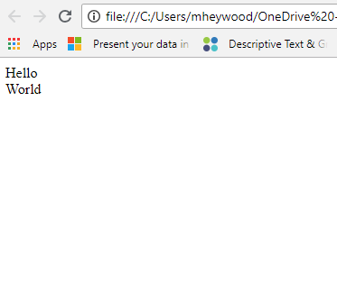

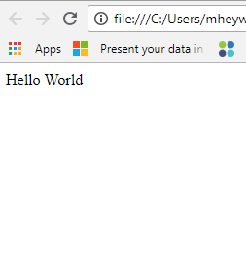

Block Versus Inline Elements
Block-level Elements
Appear on a new line from whatever content went before it and places a blank line after it
Tend to be structural elements
Paragraphs, lists, menus, footers, etc.
Online example
Inline Elements
Contained within block-level elements and only surround small parts of the web document, not full paragraphs
Doesn’t cause a new line to appear above or below the element
Anchor element, emphasis elements
Online example
Empty Elements
Not all elements have opening and closing tags
Used to insert/embed something
<img> is an empty element
Sources - Learning HTML: Guides and Tutorials" by Mozilla Developers Network is licensed under CC BY-SA 2.5

Slide 16
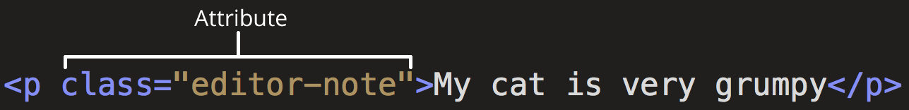
HTML Attributes
Elements can also have attributes
Provide extra information about the element but don’t want it to appear on the page
Syntax
Space between it and the element name
Attribute name followed by an “=“ sign
Attribute value with opening and closing quotes wrapped around it
Use single or double quotes, but don’t mix and match
Recommended to always use quotes
Sources - Learning HTML: Guides and Tutorials" by Mozilla Developers Network is licensed under CC BY-SA 2.5

Slide 17
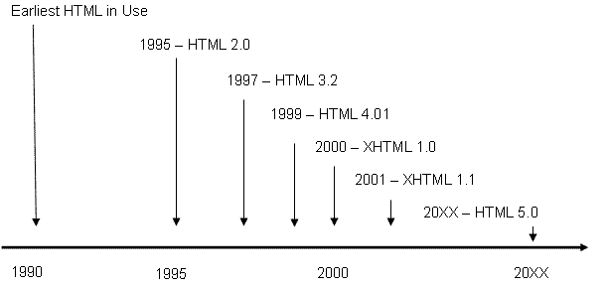
HTML Standards
W3C maintains HTML standards
2001 efforts focused on new XML (eXtensible Markup Language) language for universal markup
HTML 4 reformulated as an XML-based language called XHTML abandoning features from previous versions
HTML 5 accepted in 2014 incorporated features of HTML and XHTML (backwards compatible)
Added new elements too
Standard we use in this course
Source - Floyd, Kevin and Kwak, Myungjae, "Web Development" (2016). Computer Science and Information Technology Grants Collections. 7. https://oer.galileo.usg.edu/compsci-collections/7 Licensed under CC-BY

Slide 18
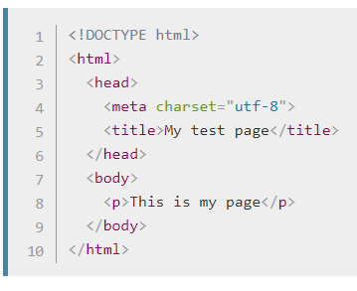
HTML 5 Template
<!DOCTYPE html> - sets standards for validating a web document
Not as important in HTML 5 but still needs to be included
<html></html> - wraps all page content, AKA root element
<head></head> - container for all content meant for browsers and not meant for the user to see
E.g., keywords, page description, CSS rules, etc.
<meta charset=“utf-8”> - sets the character set for the document
<title></title> - sets title of the page in browser tab
<body></body> - contains all content that you want users to see on the page
Source - "Learning HTML: Guides and Tutorials" by Mozilla Developers Network is licensed under CC BY-SA 2.5

Slide 19
HTML 5 Practice
W3Schools and Khan Academy have demos you can work with using live HTML 5 examples. Do your coding in the left panel to see the output in the right panel. Please note that W3Schools requires you to click on “Run” to see the output. You can also take advantage of the Quizlet app for a Unit 1 Study Guide.
W3Schools HTML 5 Template Practice
Khan Academy HTML Basics Video and Practice
Unit 1 Study Guide on Quizlet
Sources - "Intro to HTML/CSS: Making webpages" by Kahn Academy is licensed under CC BY 4.0
HTML Examples from W3Schools.com, copyright Refsnes Data

